Slide 1

Obstacle Avoidance Robot/vehicle
By-Om Chaudhari(A258)

Slide 2
Introduction
🠺
🠺
An obstacle avoidance robot/vehicle is designed to navigate its environment safely by detecting and avoiding obstacles.
These robots are used in a variety of applications, including industrial automation, agriculture, healthcare, search and rescue operations, and even in consumer products like robotic vacuum cleaners. Here's a brief introduction to the key components and principles involved in obstacle avoidance robots/vehicles:
Notes:
Introduction

Slide 3
Working
🠺
🠺
An obstacle avoiding robot is an autonomous robot that can sense and avoid obstacles in its path by using ultrasonic sensors and turning in another direction.
It can navigate in an unknown environment and perform risky jobs that cannot be done by humans.
It may use a servo motor and a code to compute the best possible way to avoid collisions.
The robot gets information from the surrounding area through mounted sensors on the robot. Some sensing devices used for obstacle detection include bump sensors, infrared sensors, ultrasonic sensors, etc.
Notes:
Introduction

Slide 4
Algorithms for Obstacle Detection and Avoidance
🠺
🠺
Effective obstacle detection and avoidance rely on advanced algorithms that enable accurate decision-making and path planning. Dive into the key algorithms used in obstacle avoidance systems.
1)Path Planning Algorithms-Determine the most efficient route to avoid obstacles and reach the target.
2)Sensing-Gain insights into the step-by-step process of collecting data from sensors and interpreting it for obstacle detection.
3)Decision-Making Algorithms-Analyze sensor inputs and make real-time decisions to navigate around obstacles.
Notes:
Introduction

Slide 5
Components
Arduino Uno
9V Battery
LCD 16*2
Ultrasonic Distance Sensor
Hobby Gearmotor
H_bridge Motor Driver
T
5
🠺
🠺
Resistor
Potentiometer

Slide 6
Challenges in Obstacle Avoidance Systems
Power Efficiency
Sensor Noise and Accuracy
Safety and Redundancy
Dynamic Environments
T
2
🠺
🠺
Maintaining power efficiency while running obstacle avoidance algorithms continuously is essential, especially in battery-powered systems
Sensors can be affected by noise and may not always provide accurate data. Handling noisy sensor data is a challenge.
Ensuring the safety of the system, even in the event of sensor failures or software glitches, is crucial. Implementing redundancy and fail-safes can be complex.
Robots and vehicles often operate in dynamic environments where obstacles may move or appear suddenly.

Slide 7
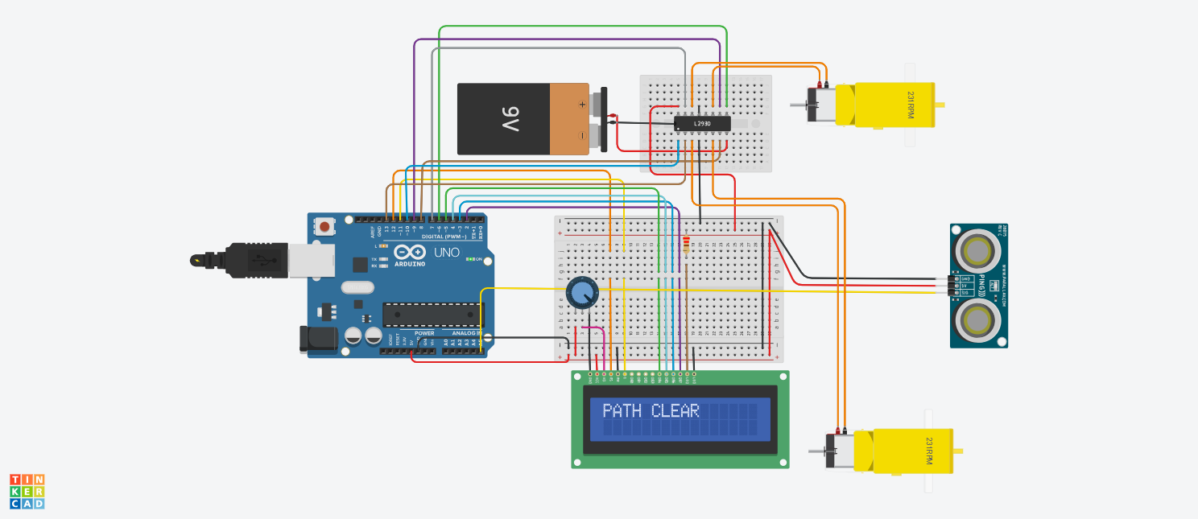
Circuit Design
🠺
🠺
https://www.tinkercad.com/things/g5hZ06ErjB5

Slide 8
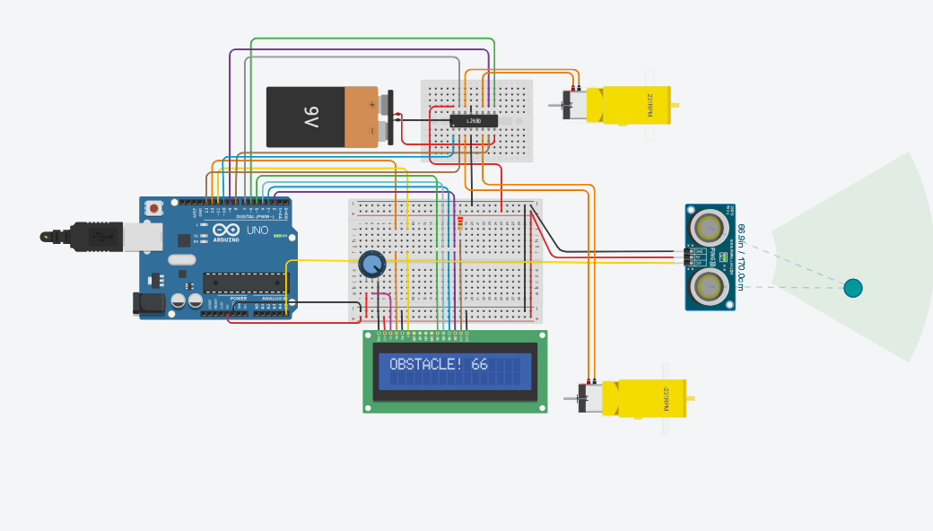
Circuit Design
🠺
🠺

Slide 9
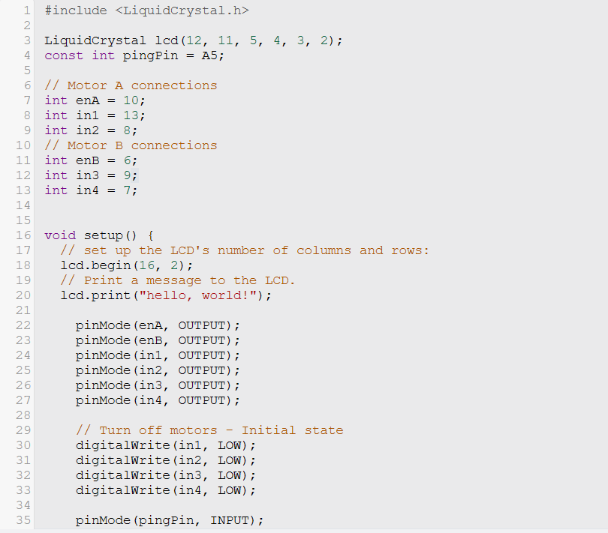
Code
🠺
🠺

Slide 10
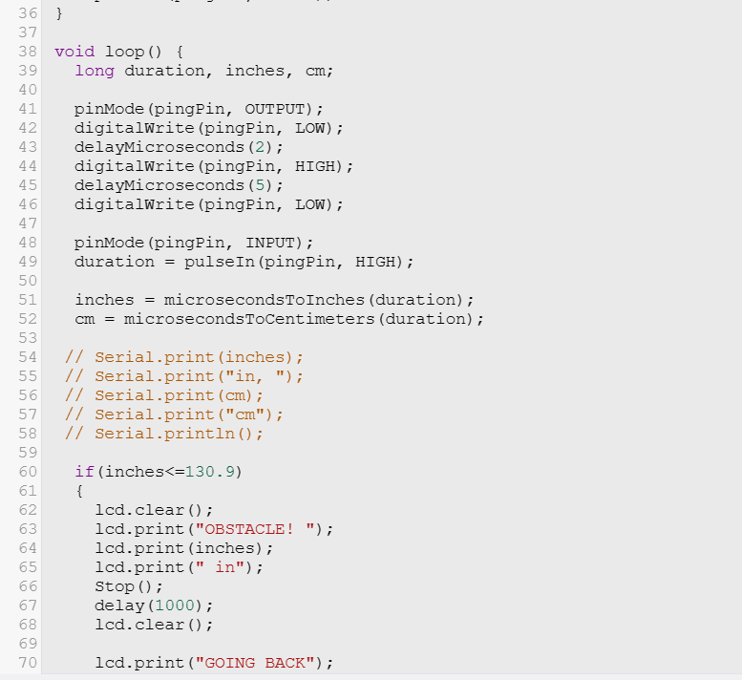
Code
🠺
🠺

Slide 11
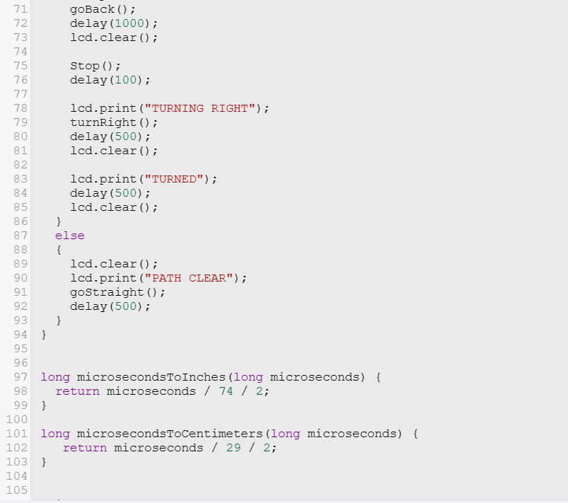
Code
🠺
🠺

Slide 12
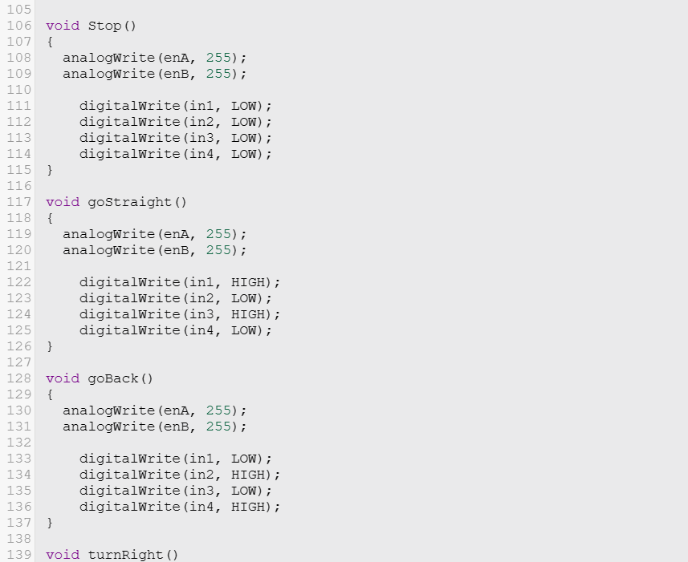
Code
🠺
🠺

Slide 13

Code
🠺
🠺

Slide 14
Conclusion
T
1
🠺
🠺
In conclusion, a well-documented and accurate obstacle avoidance robot or vehicle circuit diagram is crucial for the successful implementation of such systems. It acts as a visual guide for assembling and connecting the hardware components, helping engineers and developers ensure that the system functions as intended. This step is a fundamental part of the design process and contributes to the overall effectiveness and reliability of the obstacle avoidance system.

